Slide 1
Git Workshop
Download at https://github.com/batibot323/git-workshop
Notes:
Hi! I’m Hani Ho and I’m here to guide you on improving your Git workflows. This workshop is catered to people at a beginner or intermediate level at Git. You can find a copy of this slides on GitHub.

Slide 2
Introduction
Benefits and Git Basics
Notes:
First off, let’s discuss some benefits in mastering Git.

Slide 3
Benefits of Using Git
Never having to worry about work being lost
Great code collaboration within a team
Managing releases for different environments
Manipulate code to your liking
Ability to read and write history of code
Notes:
Here are the benefits of getting proficient at Git: Never having to worry about lost work because as long as it’s committed to Git, it’ll always be there. I would like to stress this: as long as it’s committed, we can always find ways to get it back, even if it feels like we’ve done something terrible. It also allows teams to collaborate with each other, combining features and sharing code. Getting better at Git allows your team to easily handle releases for different environments. If you need to work on a hotfix in production while at the same time, adding a specific feature from DEV? Yes, you can do it with Git! Add to this, you can manipulate code to your liking. Lastly, it allows us to read and write the history of our code.
This will be a workshop so be prepared to write trivial code. If you’re not ready with an IDE, we can also just use Git on .txt files.

Slide 4
Workshop Flow
What is Git?
Install & Setup
Commits & Branches
Git Config & Aliases
Save Points During Development
Managing Commits to Tell a Story
Merge Conflicts
Resolving
Reducing
Managing Releases
Team Git Workflows
Notes:
So if that enticed you, let’s look at the flow of this workshop. First, a brief overview of Git then, we’ll go to installation and setup. We’ll use Git CLI since it offers us full functionality. Next is a primer on commits and branches to make sure we’re on the same page. Then, we’ll set up our Git config and aliases so a few specific commands will have more descriptive names.
After the basics, we’ll move on to personal workflows that can improve our development process and collaboration with others. Next, we’ll take a look at the infamous merge conflicts and how to effectively resolve them. I think we’re being hindered by our Git tools and it’s much easier to do it using Git CLI. Aside from that, we’ll discuss ways to reduce merge conflicts for smoother teamwork.
Once we’re comfortable with our personal workflows, we can move on to empower the team with our Git expertise. We’ll discuss managing releases, selecting features to include, and handling of scenarios relating to different environments. Lastly, we’ll talk about Team Git Workflows that empower us in our chosen release strategy. Whether it’s CI/CD with numerous deploys per day or just weekly deploys.
So, let’s move on to the basics of Git.
Note: Discussion on Git tools/GUI vs Git CLI will be discussed on installation.

Slide 5
What is Git?
Source Control Management (SCM)
Tracks and manages changes to code
OR Version Control System (VCS)
Allows handling of different versions
Allows collaboration between developers
Infamously riddled with difficult merge conflicts
Distributed SCM/VCS
Whole repo lives in each local, and just sync through a remote repo
Notes:
First off, what is Git? What are these fancy words? Source Control Management? Distributed SCM? Basically, Git tracks and manages changes to our code. It sounds simple yet it’s powerful. Another name for it is version control system, which for me, describes it much better. It allows us to handle different versions of code, the version in which you are developing feature A, or another version wherein your teammate is working on another feature. This also includes the older version that has been deployed to production, and the newer version in which developers are writing new features in. It also allows combining of versions, ending up in a version with all the features from all developers. This is more commonly known as merging, when merge conflicts infamously make our lives difficult.
Furthermore, it’s a distributed system, which just means that the repo resides in everyone’s machines and is synced through a remote repo. This is different from a centralized one wherein there’s only one server and many clients. In this case, the server holds all the versions and the clients just get it from the server. Whereas in Git, each one has access to all the versions and branches of the remote repository. Disclaimer: I’m not quite sure about the centralized one. Anyway, let’s move on to Git’s building blocks: commits & branches

Slide 6

What are Commits?
Snapshots of your code base
You can always go back to any specific commit
Unique ID is made by hashing the contents, date, time, and etc.
You can have exactly the same code base but different commits
Let’s treat it as the indivisible unit of work
Notes:
So, commits are snapshots of your code base, or I also see them as save points. You can always go back to any specific commit. Actually, you can save your Git repo from virtually any disaster, it could be a wrongful push, merge, rebase, etc. Looking at the commit below: we can see its commit ID, ee35dd, and the branches that are currently pointed to it. The name and e-mail of the author is also there, including the date, and the commit title and message.
Let’s look at the commit ID, this ID is unique and is actually the hash of your contents, date, and etc. So this means that, we could have the exact same contents for our repo but different commits. As for the purposes of this workshop, let’s treat commits as the indivisible unit of work. It’s like an atom, there’s nothing smaller than it. You can arrange atoms, combine or remove them. Basically do anything you want, but you can’t split them. Same thing for our commits. Next, we have branches.

Slide 7

Git Branches
Lightweight, movable pointer to a commit
Line of development
Notes:
Superficial use of Git branches mimic plant branches in real life. You have the main thick trunk, from which various branches connect. This is similar to Git’s main/master, and its feature branches. However, I’m afraid the analogy falls short as soon as you talk about Git branches’ main use, and that is merging. Another way to think about this is that branches are lines of development. These lines can intersect, converge, or even create new lines. Examples of these lines would be, a line dedicated to working on the login page, one for the user profile, and others for various features. There could also be lines pertaining to each environment, this one’s for dev, that one’s for production.
However, its actual definition according to [Pro Git] is “a lightweight, movable pointer to a commit”. But, for simplicity’s sake, let’s just look at it as a line of development.
Resources:
https://git-scm.com/book/en/v2/Git-Branching-Branches-in-a-Nutshell [Pro Git]
https://www.atlassian.com/git/tutorials/using-branches/git-merge

Slide 8
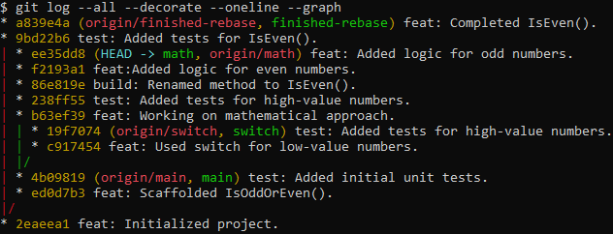
Another Example of Git Branches
Notes:
So here is a more detailed example of Git commits and branches. This Git history shows us someone who wants to implement a simple method for determining if a number is even. First thing he does is do it using a switch-case, as you can see from the switch branch on the right. He initialized the project, scaffolded, wrote tests but stopped developing. Instead he tried the mathematical approach on the math branch. Then, there’s another branch called the finished-rebase whose contents are exactly the same as the math branch. But, it has much less commits. We’ll discuss the motivation for this branch with lesser commits soon.

Slide 9
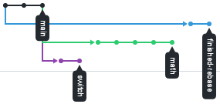
Another Example of Git Branches
Notes:
So here is a more detailed example of Git commits and branches. This Git history shows us someone who wants to implement a simple method for determining if a number is even. First thing he does is do it using a switch-case, as you can see from the switch branch on the right. He initialized the project, scaffolded, wrote tests but stopped developing. Instead he moved on to develop using a mathematical approach on the math branch. Then, there’s another branch called the finished-rebase whose contents are exactly the same as the math branch, but it has much less commits. We’ll soon discuss the motivation for this branch with lesser commits. But first off, let’s work on installing and setting up Git.

Slide 10
Installation

Slide 11
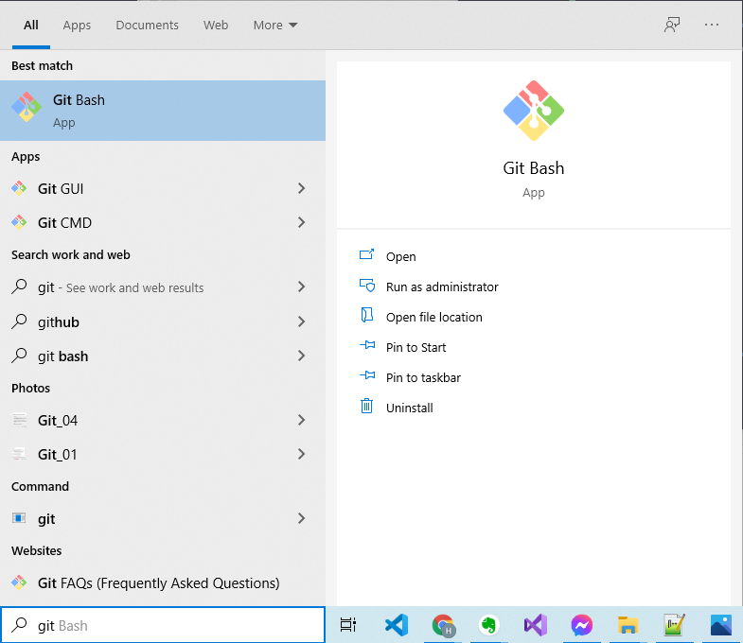
Verifying Git Bash and Git GUI
Search for “Git” on Windows
Check if you have “Git Bash” and “Git GUI”
Slightly recommended but normal Git CLI will do
Notes:
For this workshop, having Git Bash and Git GUI will be only slightly recommended. Worry not since I believe we all have Git installed but not necessarily these tools. Using normal CLI is fine as it’ll still be able to read Git commands. But for those who want to follow along, here are the steps. This should be pretty straightforward but I’ve still provided images just to make sure.

Slide 12
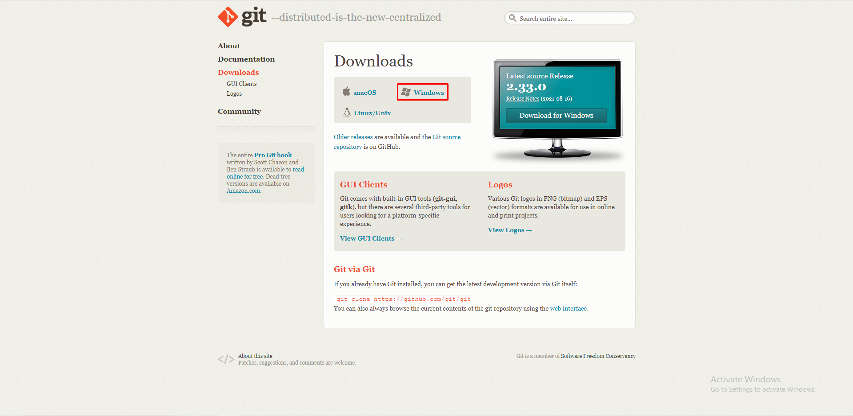
Download From https://git-scm.com/downloads

Slide 13
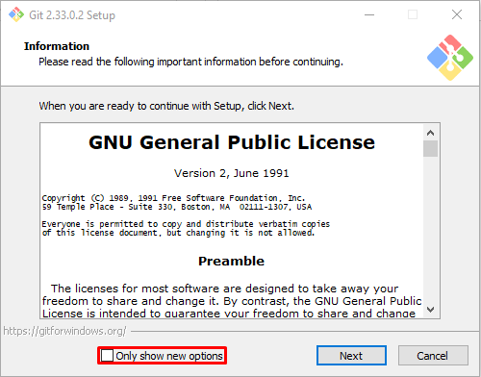
Installer Steps

Slide 14
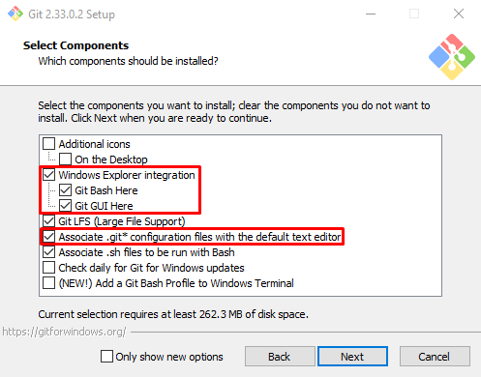
Installer Steps

Slide 15
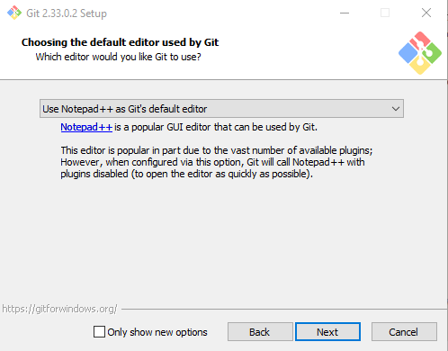
Installer Steps

Slide 16
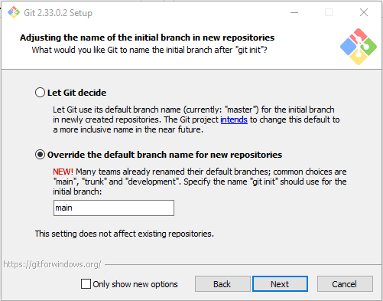
Installer Steps

Slide 17
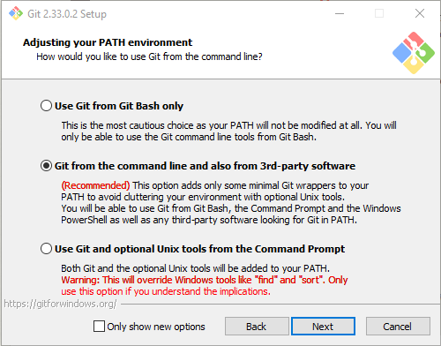
Installer Steps

Slide 18
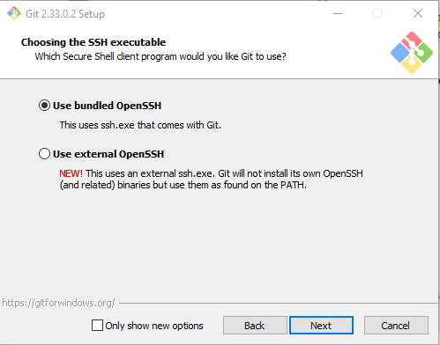
Installer Steps

Slide 19
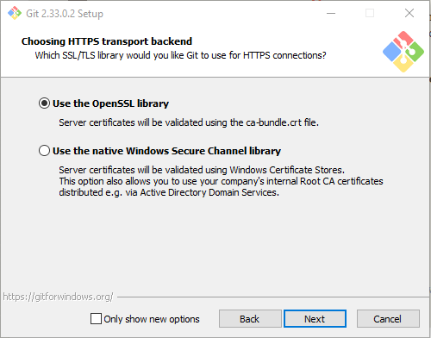
Installer Steps

Slide 20
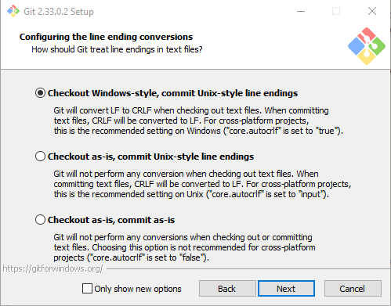
Installer Steps

Slide 21
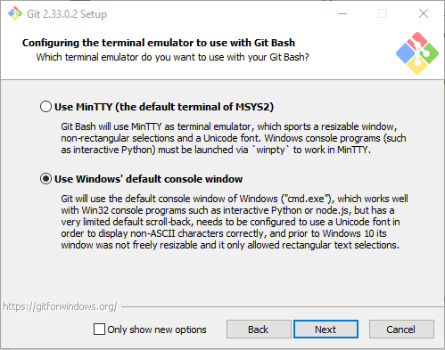
Installer Steps

Slide 22
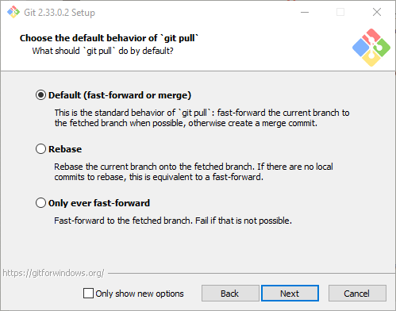
Installer Steps

Slide 23
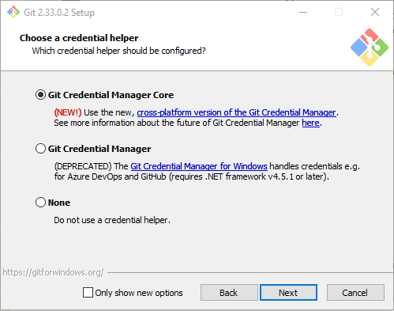
Installer Steps

Slide 24
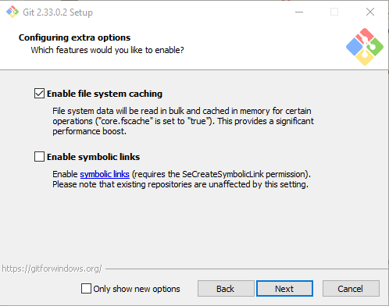
Installer Steps

Slide 25
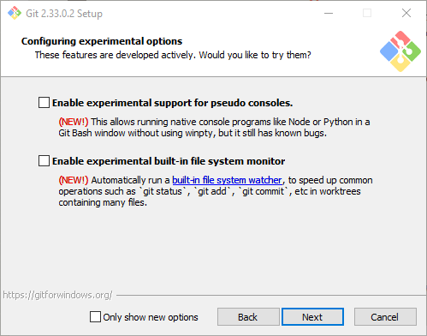
Installer Steps

Slide 26
Git Config - Aliases
Notes:
After quickly running through those numerous steps, we can now continue on to setup Git aliases.

Slide 27
Git Aliases
Go to your %userprofile% folder
Just enter %userprofile% in the address bar of Windows Explorer
Open .gitconfig
Copy contents into .gitconfig from here
https://raw.githubusercontent.com/batibot323/git-workshop/main/demo.gitconfig
Notes:
Git aliases allow us to set another name for our commands. That way, we don’t have to memorize commands that we frequently use, especially with many parameters. Just like the one we used before to show the graph of commits and its branches. Git aliases are located in the .gitconfig file on your Users folder. You can either set this through Git CLI or edit the .gitconfig directly. I strongly suggest that you edit it directly and paste the contents from this sample .gitconfig file. Go to the GitHub repo for this workshop, open demo.gitconfig. Then, click Raw.

Slide 28
Git Aliases Using CLI
git config --global alias.co checkout
git config --global alias.br branch
git config --global alias.ci commit -a -m
git config --global alias.l !git log --pretty=oneline
git config --global alias.piggy-back !git add * && git commit --amend --no-edit
git config --global alias.amend !git commit --amend -a -m
Notes:
If ever you’re a masochist, you can do it by typing these commands. So, now that we’ve got that out of the way, we can move on to the meat of this workshop.

Slide 29
Personal Git Workflows
Notes:
Git Workflows!

Slide 30
Workshop Flow
What is Git?
Install & Setup
Commits & Branches
Git Config & Aliases
Save Points During Development
Managing Commits to Tell a Story
Merge Conflicts
Resolving
Reducing
Managing Releases
Team Git Workflows
Notes:
To refresh our memories, here are the things we’re going to discuss:
Save Points During Development
Managing Commits to Tell a Story
Merge Conflicts
Managing Releases AND
Team Git Workflows

Slide 31
Save Points During Development
Try the switch-case approach
See that it’ll fail, go back in time!
Try the mathematical approach
Notes:
I strongly suggest we all follow along so we can: 1.) Make sure it’s working on our end and 2.) Learn this much better!
We don’t necessarily need to have the same code especially since I’ll be using C# and not everyone have C# set up on their machines. But I recommend that you do it in your language of choice or at the very least, using pseudocode on .txt files. Using Git will be our main focus so this will just be trivial code.
In this workflow, we’ll assume the position of someone developing a feature difficult for them. So, we’re going to try to employ two possible solutions since we don’t know which one will work yet. We also know basic TDD, so we’re going to write tests as part of our workflow. We’re going to work on creating a function that returns true if the number is even. Sounds familiar? We’re going to walk through one of the examples given at the start.
We are thinking of two potential solutions: 1.) using a switch-case statement and 2.) doing it mathematically. So, first up, we’ll try the switch-case approach. Then, see that it’ll fail so we go back in time! Then, we’ll go on to do it mathematically! I’ll start sharing my screen so we can all follow along. Don’t hesitate to ask questions or ask me to slow down if I’m going too fast.

Slide 32
Save Points During Development
Saving = Committing
More frequent, smaller commits
More specific savepoints to load
Loading = git reset --hard <commit-id>
Create temp branches before loading
Easier to keep track of changes
git reflog
Magic button to undo any Git disaster
Keeps tracks of all commits we’ve pointed to

Slide 33
Managing Commits to Tell a Story
Many small commits are good for personal development
Few large commits are good for team collaboration
Much easier to handle releases if one feature = one commit
Balance between commits being indivisible
Operate at different zoom levels
Zoomed in when developing features
Zoom out to look at the bigger picture when handling releases

Slide 34
Managing Commits to Tell a Story - Rebase
git rebase -i <parent-id>
id of the parent you want to start rebase on
Very powerful
Combine, edit, rename, reorder, and delete commits
You should rebase your feature before merging and pushing to dev
NEVER use on a public branch
Don’t use on dev, qa, or prod

Slide 35
Merge Conflicts - Resolving
Sometimes it’s better to resolve them manually
Fix each file with conflict by removing the conflict markers
>>>, ===, <<<
Commands:
git add *
git merge --continue

Slide 36
Merge Conflicts - Reducing
Devs may sync their changes back to dev ASAP if they all are changing the same files
Syncing your scaffolds ASAP makes it easier for future merges
However, this is contrary to only having large commits in our remote repo
Price we have to pay

Slide 37
Team Git Workflows

Slide 38
Managing Releases
Usually dev only has all the features it exactly needs
Tag this commit so it’s easier to keep track
git tag -a v3.5.7 -m “Added stories and replies to comments.”
git push origin v3.5.7
Can use revert or cherry-pick to further manipulate commits in dev
revert creates a commit that will undo a specific commit
cherry-pick allows us to get commits from an unmerged/unfinished branch and apply it to dev
Notes:
For now, let’s just assume that we only have one main branch or trunk, and that is dev. Usually dev is ready for releases since it contains all the features. However, you may need to do reverts or cherry-pick based on the scenario.

Slide 39
Team Git Workflows
Gitflow
Trunk-based workflow

Slide 40
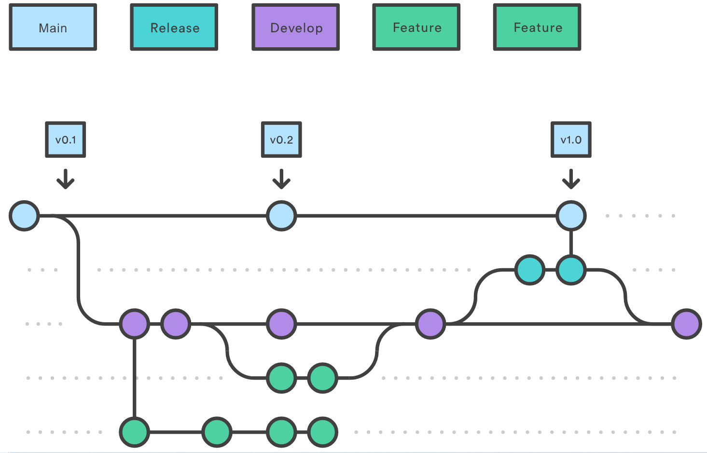
Gitflow
Having separate branches for each environment
Easier to track which versions of code are in each environments
Features are only merged once they’re finished
Notes:
Resources:
https://www.atlassian.com/git/tutorials/comparing-workflows/gitflow-workflow

Slide 41
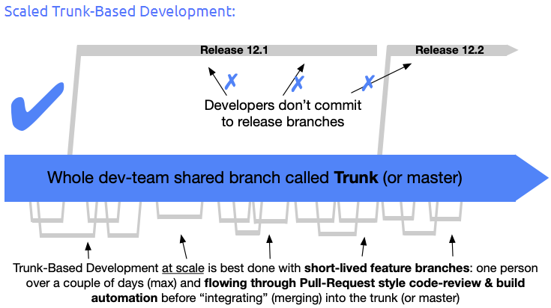
Trunk-Based Workflow
Characterized by short-lived branches
Usually used in conjunction with CI/CD
Notes:
Resources:
https://trunkbaseddevelopment.com/

Slide 42
Summary
Git CLI allows full functionality
Git Aliases
Personal Git Workflows
Save Points
Editing History - Rebase
Merge Conflicts
Team Git Workflows
Managing Releases
revert and cherry-pick
Gitflow
Trunk-based development

